Slide 1
Revision – unit 4
Food
Nouns
Quantity
Articles

Slide 2
Da li su imenice koje su podebljane brojive ili nebrojive?
The children are playing in the street.
I don't like milk.
I love tea.
My mother makes cookies with butter.
There are a lot of windows in our house.
The waiters in this restaurant are very kind.
My father drinks two big glasses of water every morning.
The bread my grandma prepares is delicious.

Slide 3
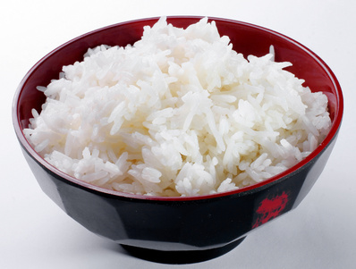
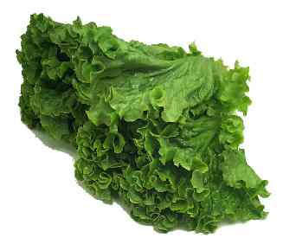
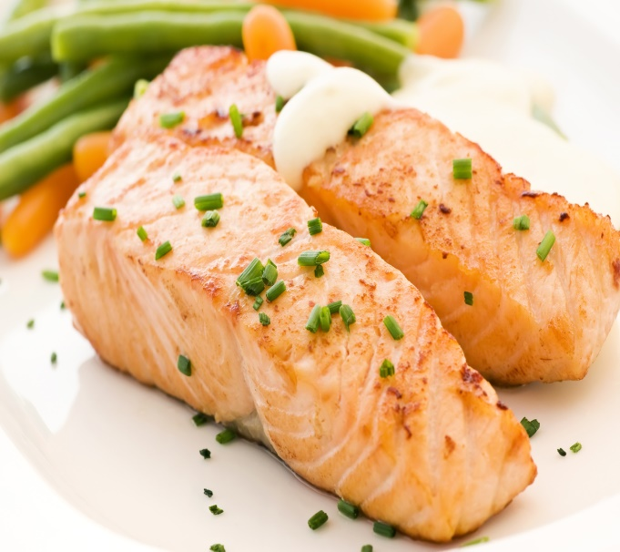


What’s an English word for:

Slide 4
Upiši odgovarajući član (a, an, the):
I saw ....... movie last night.
They are staying at ........ hotel.
Look at ....... woman over there! She is a famous actress.
I live in ..... apartment. ....... apartment is new.
I would like ....... piece of cake.
I was in ..... Japanese restaurant. ...... restaurant served good food.

Slide 5
SOME or ANY:
Do you have ......... bread?
She bought ........ new shirts.
There isn’t ........ milk in the fridge!
Is there ...... orange juice in the supermarket?
There are ...... people in front of our house.
She bought ...... some flowers this morning.

Slide 6
MUCH or MANY:
How ........ money do you need?
How ........... friends do you have?
How ........... apples do you need for your pie?
How .......... bottles of water did you buy?
How ......... water do you drink every day?

Slide 7
Kako se sledeće reči kažu i pišu na engleskom?
Pileće meso
Goveđe meso
Svinjsko meso
Jagnjeće meso
Testenina
Sir
Limunada
Kafa
Losos
Tunjevina

Slide 8
Vežbanja sa prethodnih slajdova nije potrebno slati nastavnici, već samo uraditi u svesci. ☺

